Slide 1



Unveiling META Champions in League of Legends
Data-Driven Analysis of the 13.24 Patch

Slide 2

INTRODUCTION
League Of Legends Overview

Slide 3

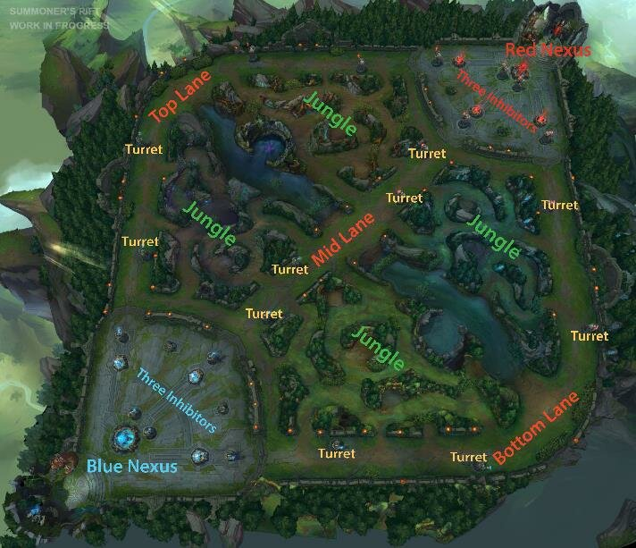
5v5 Team-Based Strategy
Main Objective: Nexus Destruction

Slide 4

166
+200
champions each with unique abilities. Champions categorized by roles—Top, Jungle, Mid, ADC, Support.
Items that champions can purchase, offering various stats and abilities to enhance performance.

Slide 5

Game Imbalance and the Emergence of META
Inherent Imbalance
Patch Updates
Impact of Player Innovation

Slide 6
META
Most Effective Tactics Available

Slide 7
Primary Objective
Identify and analyze META champions in the League of Legends 13.24 patch.

Slide 8

TABLE OF CONTENTS
01
02
03
04
DATA ACQUISITION
DATA INTEGRATION
DATA CLEANING
DATA QUALITY

Slide 9
TABLE OF CONTENTS
05
06
DATA STORAGE
QUERIES

Slide 10

01 - DATA ACQUISITION
API
SCRAPING
Riot Games
LoLalytics
Op.gg
blitz.gg

Slide 11
API from RIOT Games
Data Retrieval: Used Riot API to fetch the official list of LoL champions and their basic stats not linked to in-game performances.
Data Format: Data received in a hierarchical JSON format, with each champion's name as a key linked to their detailed information.
Data Transformation: Processed and flattened the data into a structured table using Python's pandas library for easier analysis.
Dataset Overview: The final dataset, named 'champion_list.csv', contains 30 columns for various champion attributes and 166 rows representing each champion.

Slide 12
SCRAPING
BeautifulSoup
Selenium
Python library for parsing HTML and XML,
Python library for dynamic content handling in web pages.

Slide 13
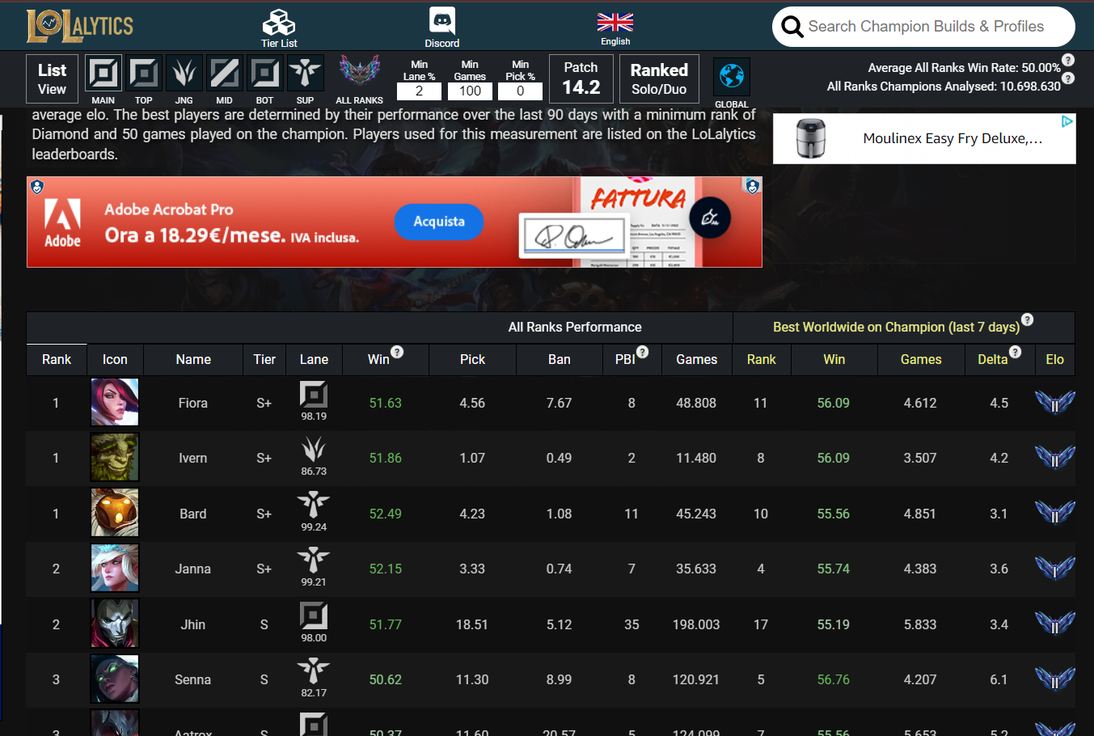
SCRAPING LoLalytics
URL Example
50 distinct URL Calls
https://lolalytics.com/lol/tierlist/?lane=top&tier=emerald
different URLs based on lane and tier

Slide 14
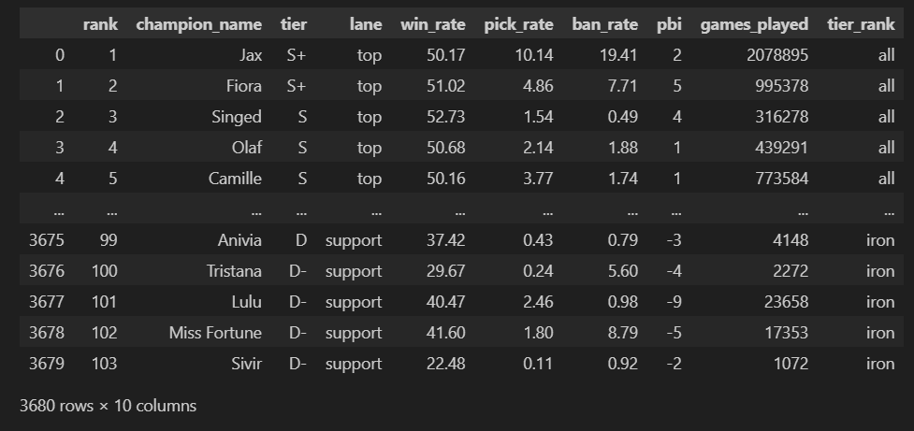
Final Dataset - LoLalytics

Slide 15
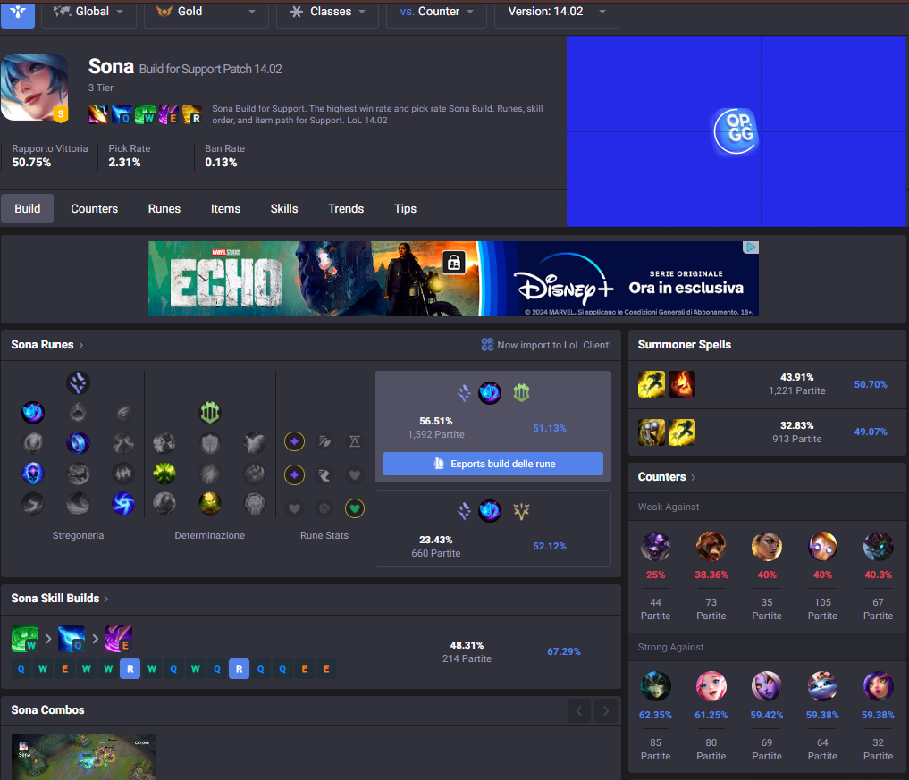
SCRAPING op.gg
URL Example
3656 distinct URL Calls
https://www.op.gg/champions/sona/build/support?tier=gold
different URLs based on champion, lane and tier

Slide 16
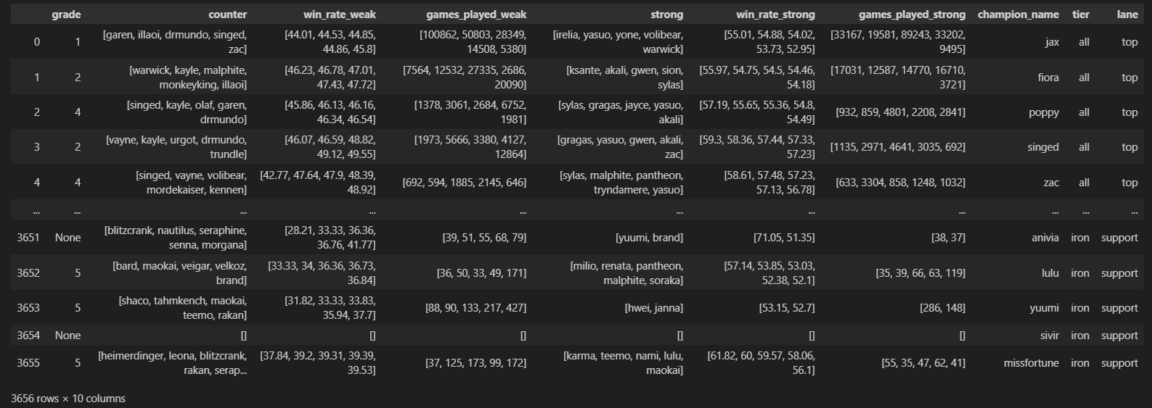
Final Dataset - op.gg

Slide 17
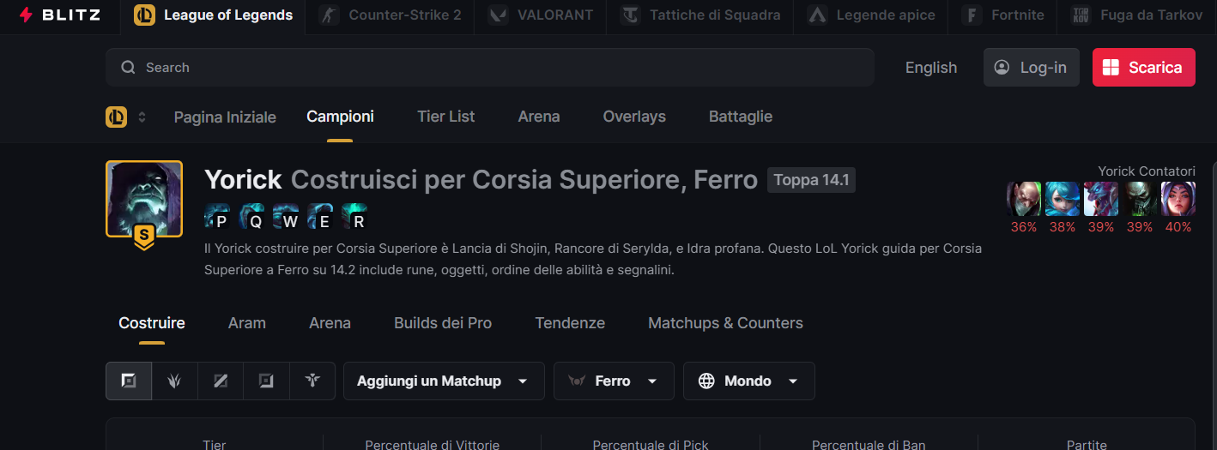
SCRAPING blitz.gg
URL Example
3656 distinct URL Calls
https://blitz.gg/lol/champions/Yorick/build?queue=RANKED_SOLO_5X5&region=WORLD&tier=IRON&role=TOP
different URLs based on champion, lane and tier

Slide 18
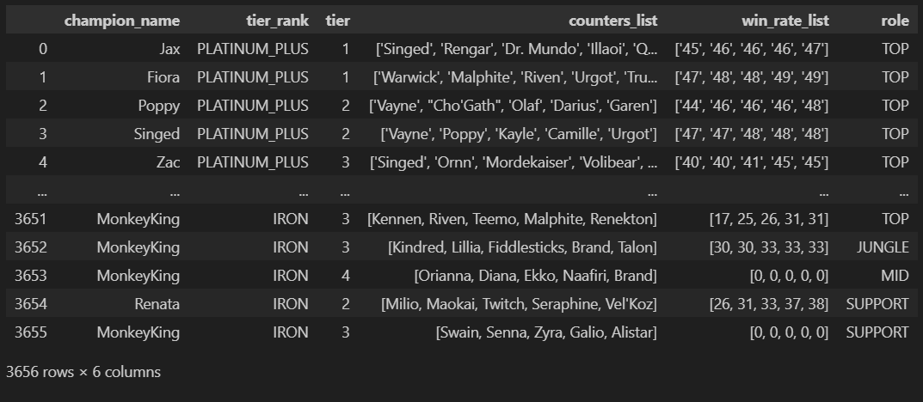
Final Dataset - blitz.gg

Slide 19


02
DATA INTEGRATION

Slide 20



INTEGRATING DATA
LOLALYTICS
OP.GG
BLITZ.GG
Merging based on champion, lane, and ranking.

Slide 21
Addressing Data Overlaps
A
B
OVERLAPPING DATA
RESOLUTION STRATEGY
'Trust Your Friends' approach to prioritize data from op.gg.
Challenges with 'Counter' and 'Win Rate Weak' from op.gg, and 'Counters List' and 'Win Rate List' from blitz.gg.

Slide 22
DIVERSE GRADING CRITERIA
MEET IN THE MIDDLE
LOLALYTICS
OP.GG
BLITZ.GG
relies on in-game metrics collected from users of the Blitz app.
takes into account 'Win Rate', 'Pick Rate', and 'Ban Rate'. It also includes metrics that represent a champion's maximum potential, which is derived by analyzing the performances of top-tier players using that champion.
considers a combination of factors such as 'Win Rate', 'Pick Rate', and 'Ban Rate' for each champion.

Slide 23
03
DATA CLEANING
Preparing data for storage and analysis

Slide 24
DATASETS IN THIS PHASE
champion_list.csv
complete.csv
Dataset from RIOT API
Integrated Dataset from LoLalytics, op.gg and blitz.gg

Slide 25
Structuring the champion_list Dataset
A
B
DATA DIVISION
DERIVED TABLES
Split into five tables for detailed data management.
Champion_name
tags
Champion_tags
Champion_base_info
champion_base_stats

Slide 26
Structuring the complete.csv Dataset
A
B
DATA DIVISION
DERIVED TABLES
Split into four tables for detailed data management.
Game_stats
Matchup
Lane
Ranking

Slide 27
Detailing the 'game_stats' Table
Purpose: Captures in-game statistics of champions, organized by lane and ranking.
Column Calibration: Adjusted 'position' column to align with custom grades for consistency.

Slide 28
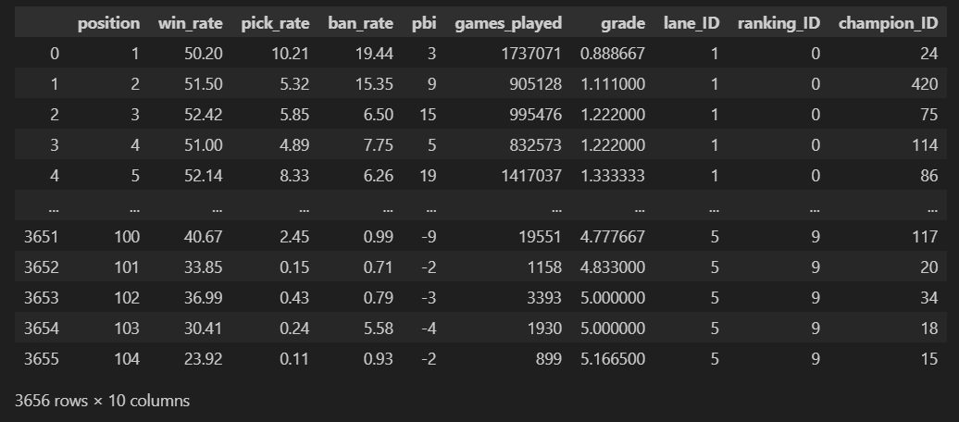
Detailing the 'game_stats' Table

Slide 29
Constructing the ‘matchup’ Table
Preprocessing Challenge: Extensive handling of columns with list-type data as strings.
Data Expansion: Increased from 3,656 to 30,925 rows for each unique champion, lane, and ranking combination.
Detailed Insights: Provides in-depth data on champion matchups, including win rates and games played.

Slide 30
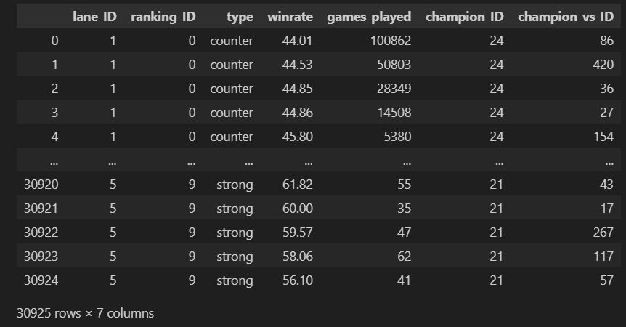
Constructing the ‘matchup’ Table

Slide 31
04
DATA QUALITY

Slide 32
DATA QUALITY DIMENSIONS
Consistency
Completeness
logical correlation between various data points within the dataset
dataset's ability to inclusively cover all necessary information

Slide 33
ENSURING WINRATE CONSISTENCY
Win Rate Criteria for Consistency:
Counters’ Win Rates: Average win rate of counters should be less than the champion's overall win rate, in a specific lane and ranking.
Strong Against Win Rates: Champions should have a higher average win rate against champions they are strong against, in a specific lane and ranking
Inconsistencies Observed: About 3.4% of rows (combination of champion, lane, ranking) showed inconsistencies in win rate patterns.

Slide 34
ASSESSING MATCHUP COMPLETENESS
Structural Design: Dataset includes 5 counter and 5 strong-against champions for each champion-lane-ranking combination.
Formula: Object Completeness = (Number of Rows in Matchup) / (Number of Rows in Game Stats × 10)
Achieved Completeness Rates: 84.59%

Slide 35
CHAMPIONS INFO TABLE COMPLETENESS
Champion_name: 100%
Champion_base_stats: 100%
Champion_base_info: 99.5%

Slide 36
QUALITY TRADEOFF
Primary Objective: Attain the highest level of consistency in the dataset.
Strategy: exclusion of Inconsistent Matchups:

Slide 37
100%
83.3%
Consistent rows (3656 combinations of champion, lane, ranking)
New Matchup Object Completeness Rate
(1.3% drop)

Slide 38
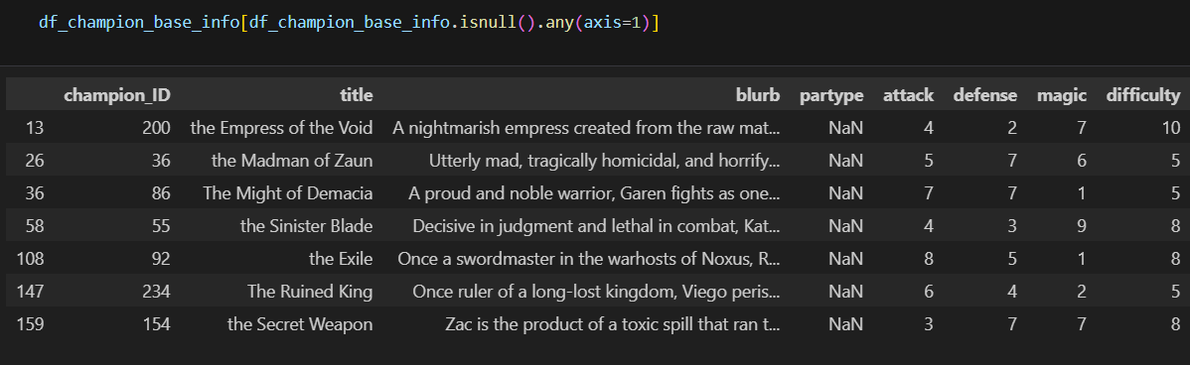
IMPROVEMENT OF CHAMPION_BASE_INFO COMPLETENESS
Replaced NaN partype to ‘Resourceless’
New Champion_base_info Table Completeness: 100%

Slide 39
05
DATA STORAGE

Slide 40
RELATIONAL MODEL - 9 TABLES
Champion
Champion_base_info
Champion_base_stats
Champion_tags
Tags
Lane
Ranking
Game_stats
Matchup

Slide 41
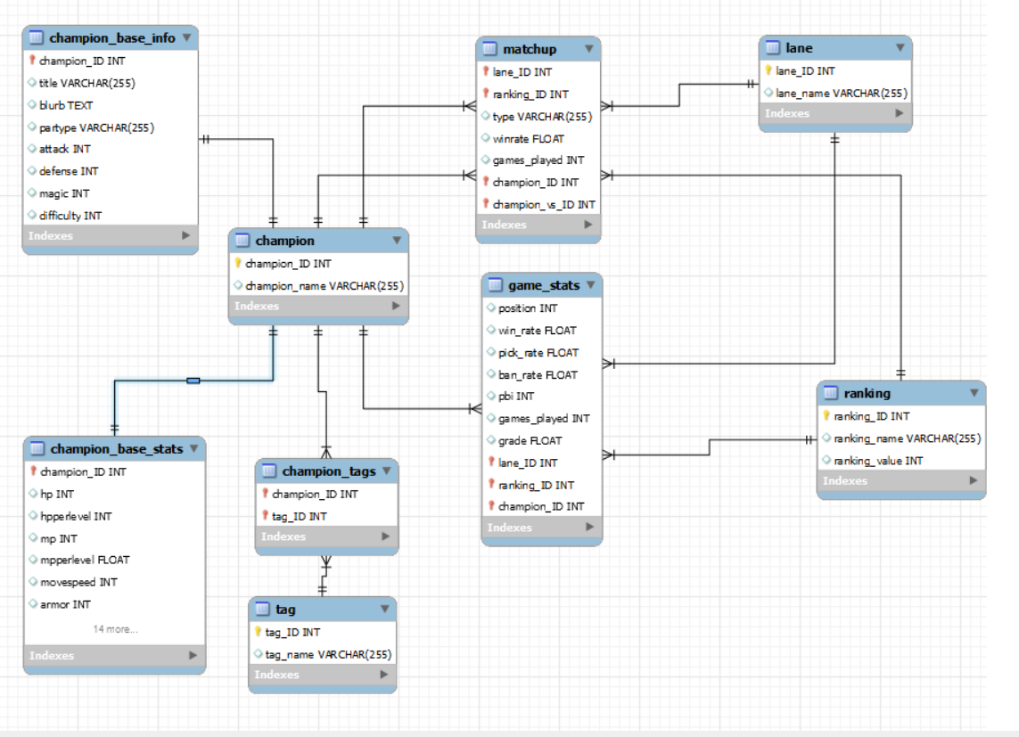
ER DIAGRAM

Slide 42

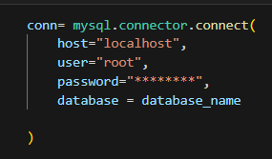
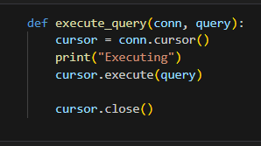
TECH Stack for Data Storage
MySQL Workbench
Mysql.connector (python library)
Custom Functions on Python

Slide 43
Custom Functions in python
CREATE
INSERT
get_create_table_query
get_insert_query
Parameters:
Df
table_name
Return: insert_query
Parameters:
Df
Primary_keys
Table_name
Foreign_keys (optional)
Return: create_table_query

Slide 44
06
QUERIES
Unveiling META Champions

Slide 45
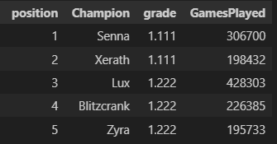
Query 1: TOP 5 Champions to play in support role, rank Gold
SELECT position, champion_name AS Champion, grade, games_played AS GamesPlayed
FROM game_stats
JOIN champion ON game_stats.champion_ID = champion.champion_ID
JOIN lane ON game_stats.lane_ID = lane.lane_ID
JOIN ranking ON game_stats.ranking_ID = ranking.ranking_ID
WHERE lane_name = 'support' AND ranking_name = 'gold'
AND position BETWEEN 1 AND 5
ORDER BY position ASC

Slide 46
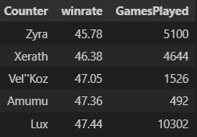
Query 2: How to Counter Senna, in support role, ranking Gold
SELECT vs_champion.champion_name AS Counter, winrate, games_played AS GamesPlayed
FROM matchup
JOIN lane ON matchup.lane_ID = lane.lane_ID
JOIN ranking ON matchup.ranking_ID = ranking.ranking_ID
JOIN champion ON matchup.champion_ID = champion.champion_ID
JOIN champion AS vs_champion ON matchup.champion_vs_ID = vs_champion.champion_ID
WHERE ranking_name = 'gold' AND champion.champion_name = 'Senna' AND lane_name = 'support' AND type = 'counter'
ORDER BY winrate ASC

Slide 47
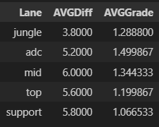
Query 3: Average difficulty and grade of META Champions (top 5) for every lane in bronze ranking
SELECT lane.lane_name AS Lane, AVG(champion_base_info.difficulty) AS AVGDiff, AVG(game_stats.grade) AS AVGGrade
FROM game_stats
JOIN ranking ON game_stats.ranking_ID = ranking.ranking_ID
JOIN lane ON game_stats.lane_ID = lane.lane_ID
JOIN champion_base_info ON game_stats.champion_ID = champion_base_info.champion_ID
WHERE (position BETWEEN 1 AND 5) AND ranking_name = 'bronze'
GROUP BY lane.lane_name

Slide 48
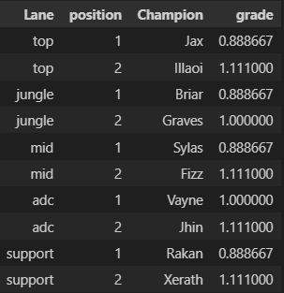
Query 4: Considering all rankings, who are the top 2 champions for every role?
SELECT lane_name AS Lane, position, champion_name AS Champion, grade
FROM game_stats
JOIN ranking ON game_stats.ranking_ID = ranking.ranking_ID
JOIN champion ON game_stats.champion_ID = champion.champion_ID
JOIN lane ON game_stats.lane_ID = lane.lane_ID
WHERE (game_stats.position BETWEEN 1 and 2) AND ranking_name = 'all'
ORDER BY game_stats.lane_ID ASC, position ASC

Slide 49
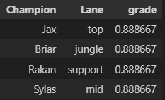
Query 5: who are the champions whose grade < 1, considering all rankings? (Overpowered Champions)
SELECT champion_name AS Champion,
lane_name AS Lane, grade
FROM game_stats
JOIN champion ON game_stats.champion_ID = champion.champion_ID
JOIN lane ON game_stats.lane_ID = lane.lane_ID
JOIN ranking ON game_stats.ranking_ID = ranking.ranking_ID
WHERE ranking_name = 'all' AND grade < 1

Slide 50
07
CONCLUSIONS

Slide 51
GOAL
uncover the most effective champions in League of Legends patch 13.24.

Slide 52
ACCOMPLISHMENTS
Comprehensive Data Analysis: Successfully gathered, integrated, and analyzed data from multiple sources to identify top-performing champions.
Insightful Findings: Uncovered patterns in champion performance
Foundation for Future Exploration: Established a basis for further analysis and visualizations, potentially through tools like Tableau.

Slide 53

THANKS!
JULIUS MALIWAT - 864520

